Slide 1
TUBERCULOSIS OF THE BONES

Slide 2
AETIOLOGY
It is caused by Mycobacterium tuberculosis
ROUTES OF INFECTION( MODES OF TRANSMISSION)
Blood stream(haematogenous)from pulmonary foci
Direct extension from a joint or soft tissue
Rarely- lymphatic spread from infected lymphnodes

Slide 3
PATHOLOGY
When the bacilli reaches the bone, there a typical tuberculous inflammatory reaction.
Part of the bone is destroyed and replaced by granulation tissue.
A tuberculous abscess is commonly formed. It tracks beneath the soft tissues or towards the surface of the body.
With treatment, there is a tendency to healing by fibrosis.

Slide 4
SITES
Vertebral column( thoracic & lumbar vertebrae)
It’s the commonest site
The infection typically affects the vertebral bodies
The vertebral bodies collapse anteriorly becoming wedge shaped resulting to Gibbus deformity( exaggerated kyphosis)
An abscess may track downwards along the vertebral column
The abscess may extend backward towards the spinal canal causing pressure on the spinal cord which may lead to paraplegia

Slide 5
Sites cont’d
2) Hands
It affects the metacarpals and phalanges causing tuberculous dactylitis
3) Feet
It affects the metatarsals and phalanges
4) Long bones( femur, tibia, radius & ulna)
It causes juxta-articular tuberculosis
It occurs as an extension of tuberculous arthritis
The articular ends of the bones are frequently eroded by tuberculosis.

Slide 6
CLINICAL FEATURES
It has a gradual( insidious) onset.
Constitutional features:
Night sweats
Fever
General malaise
Loss of weight
Some may have a cough(rare)

Slide 7
Clinical features cont’d
2. Specific features:
The depend on the site affected:
Hands and feet- Pain and swelling
Long bones- pain and stiffness of affected joint
Vertebrae- Backache, deformities( scoliosis or kyphotic Gibbus deformity)
- Cold abscess as the pus follows the psoas muscle
- Paraplegia and other neurological features

Slide 8
INVESTIGATIONS
Full haemogram + ESR
- Hb- slightly reduced
- Relative lymphocytosis
- ESR- moderately elevated( 40-60mm/hr)
2) Sputum for AAFB
3) Gastric lavage for AAFB

Slide 9
Investigations cont’d
4) Radiological investigations:
X-ray
Diffuse rarefaction around the site of infection
Erosion of the bone(juxta-articular tuberculosis)
In most cases – shadow in soft tissues denoting abscess formation.
Wedging of the vertebral bodies
b) MRI- Bone destruction, abscess, spinal cord
involvement
c) CT Scan
d) Radioisotope scanning- areas or increased
osteoblastic activity( red spots)

Slide 10
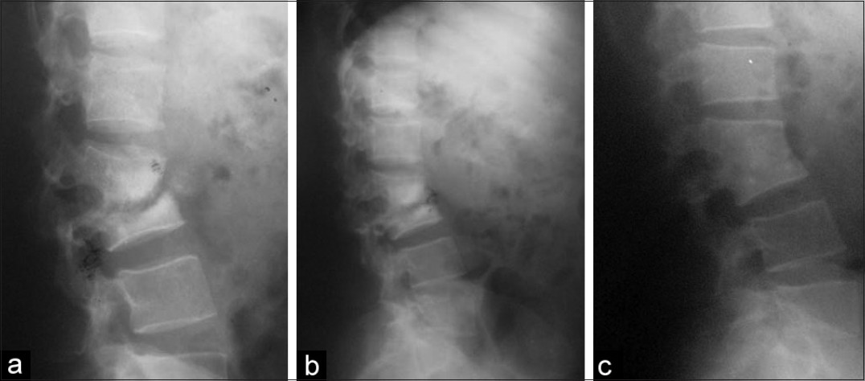
Tb spine with wedging of vertebrae

Slide 11
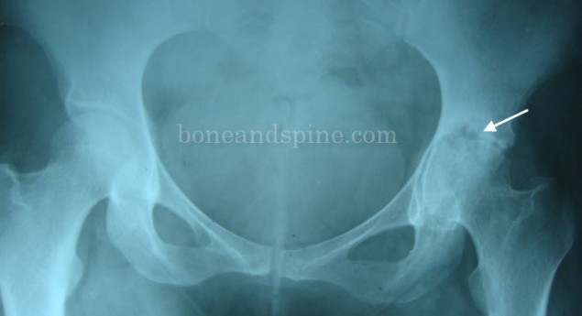
Tb of acetabulum & femoral head

Slide 12
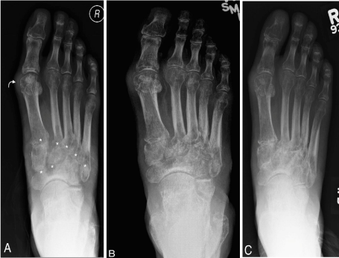
Tb of the metatarsals & phalanges

Slide 13
Investigations cont’d
5) Mantoux test- positive
6) Pus aspirate for culture
7) Biopsy of the bone or soft tissues for histology – features of tuberculosis

Slide 14
TREATMENT
Supportive treatment
Nutritional support
Correct the anaemia
Analgesics
2) Chemotherapy
Combined anti-Tb therapy for six months. Drugs are combined so a to:
- reduce resistance
- reduce the dosage of individual drugs
- reduce drug complications

Slide 15
Treatment cont’d
3) Surgery
Drainage of the abscess
Surgical decompression of the spinal cord and stabilization of vertebral column
Bone curettage and grafting
Synovectomy
Arthroplasties

Slide 16
Treatment cont’d
4) Rehabilitation
Physiotherapy
Use of crutches
Provision of wheelchairs for paraplegics

Slide 17
PROGNOSIS
The outcome of the disease may take three forms:
Heal completely
Become a chronic illness
Spread to other organs in form of milliary Tb

Slide 18
COMPLICATIONS
Permanent bone/joint destruction leading to permanent deformities
Paraplegia and other neurological complications
Spread to other organ- milliary Tb

Slide 19
ASSIGNMENTS
Syphilitic bone infection
Madurella mycetoma ( Madura foot)

Slide 20

QUOTE!!

